Slide 1
GRADUATE STUDENT ADVISING WELCOME
FALL 2017
08.26.2017

Slide 2
MEET YOUR ADVISORS
MS Data Visualization
Quizayra Gonzalez
Graduate Student Advisor
  gonzq319@newschool.edu
  6 EAST 16TH STREET, ROOM 726

Slide 3
MEET YOUR ADVISORS
Jill Corson Lake
Director of Graduate Student Advising
  corsonj@newschool.edu
6 EAST 16TH STREET, ROOM 730

Slide 4
MEET YOUR ADVISORS
Career Advising
Estefania Acosta
Career Advisor
acose018@newschool.edu
  6 EAST 16TH STREET, ROOM 728

Slide 5
WHAT ACADEMIC ADVISORS DO
Through a collaborative student-centered approach in partnership with your program director, we guide each of you in helping you to develop an educational plan to realize your goals.
As your Academic Advisors, we will…
Encourage you
Explain your curriculum & help you plan your course of study
Connect you to university resources
Support your academic progress
Share policies and procedures
Serve as a liaison between you and faculty
Help keep you on track for graduation

Slide 6
WHAT A CAREER ADVISOR DOES
Graduate career advisors assist students with:
Identifying possible internships
Creating a résumé
Reviewing a portfolio and/or website
Writing cover letters
Creating a job search strategy
Researching potential employers
Applying for jobs
Practicing for interviews

Slide 7
NAVIGATING ACADEMIA
Successful graduate students are engaged, committed, motivated, and proactive. You are self-directed and take action to:
learn to productively and professionally interact with faculty, peers, and others
seek to understand the terminology, policies, and organizational structures
identify and leverage resources to support your progression through and beyond graduate school
establish intellectual and social communities, and professional networks

Slide 8
NAVIGATING ACADEMIA
To navigate your graduate studies, you will need to:
understand the structure of your graduate field, requirements, and policies of Parsons and The New School
develop realistic expectations, effective habits and strategies for coursework, research, writing, and your overall wellbeing
create a schedule and timeline for degree completion
manage interpersonal dynamics and mentoring relationships

Slide 9
NAVIGATING ACADEMIA
To navigate your graduate studies, you will also need to:
know your funding sources and manage them proactively
seek fellowships and other funding opportunities
respond to and manage (sometimes unanticipated) academic or personal challenges
develop and maintain healthy relationships and habits supportive of your progress and success

Slide 10
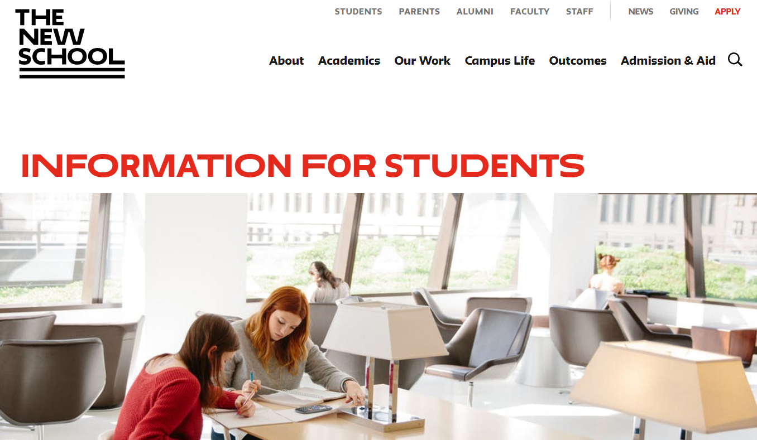
HOW TO FIND RESOURCES
www.newschool.edu/students

Slide 11
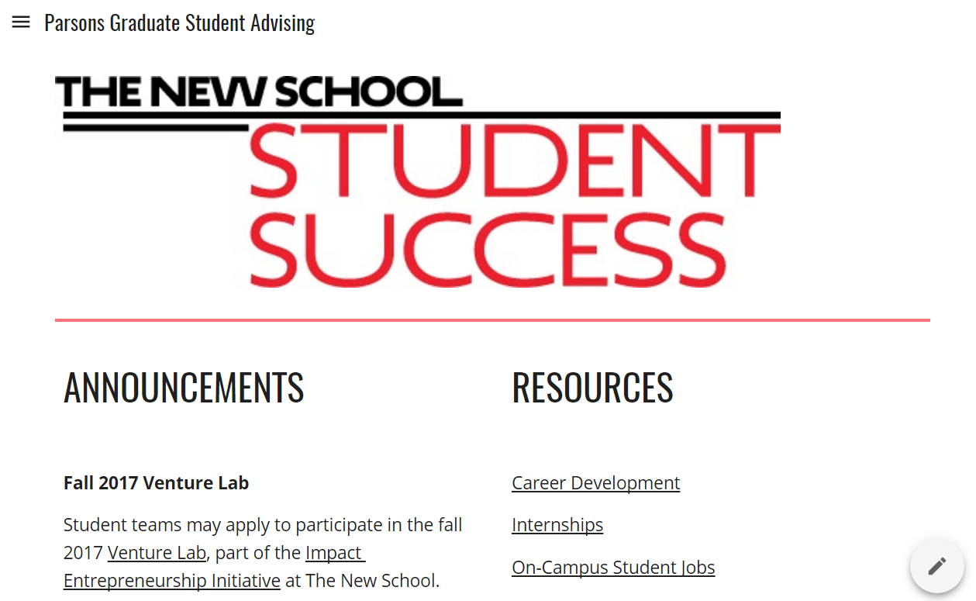
HOW TO FIND MORE
RESOURCES

Slide 12
NAVIGATING MY.NEWSCHOOL
Student Success Network “Starfish”
Degree Works – degree audit tool
Course registration, ordering transcripts
Financial aid, tuition payment, payment plans
Your course schedule
Student Gmail
Libraries, Computer Labs, Information Technology

Slide 13


Slide 14
PARSONS CATALOG
AVAILABLE ON – Parsons Graduate Student Advising website
PROGRAM REQUIREMENTS – outlines curriculum and courses required for your degree program. Provides sample semester-by-semester plans
ACADEMIC INTEGRITY POLICY – defines what constitutes plagiarism, and outlines procedures to investigate suspected plagiarism
ACADEMIC STANDING REQUIREMENTS – minimum 3.00 GPA for graduate students
GRADE APPEAL PROCESS
Notes:
Demonstrate how to navigate catalog; Elaborate on Academic Integrity (written assignments, studio assignments); Elaborate on Religious Absences (notify instructor in advance, equal opportunity to make up work); Elaborate on Attendance policy: Regular attendance essential for academic success. Absences significantly diminish educational experience. There are no excused absences.

Slide 15
PARSONS CATALOG
ATTENDANCE POLICY Students are expected to attend classes regularly and promptly and in compliance with the standards stated in the course syllabus.
      Absence from a significant portion of class time my prevent the successful attainment of course objectives. A significant portion of class time is generally defined as the equivalent of three weeks, or 20% of class time. Lateness or early departure from class may be recorded by the instructor as one full absence. Students may be asked to withdraw from a course if habitual absenteeism or tardiness has a negative impact on the class environment.
ABSENCES FOR RELIGIOUS OBSERVANCES
LEAVE OF ABSENCE one or two semesters. Complete Exit Form online – available on Academics tab of My.Newschool.edu.
Notes:
Demonstrate how to navigate catalog; Elaborate on Academic Integrity (written assignments, studio assignments); Elaborate on Religious Absences (notify instructor in advance, equal opportunity to make up work); Elaborate on Attendance policy: Regular attendance essential for academic success. Absences significantly diminish educational experience. There are no excused absences.

Slide 16
UNIVERSITY RESOURCES
COMPUTER LABS: located in:
55 W. 13th Street, 8th & 9th floors
The University Center, 13th & Fifth Ave., basement & 6th floor
6 East 16th Street, 6th, 7th, 9th, 10th, 11th floors
INTERNATIONAL STUDENT SERVICES: visas, travel/work authorization, events, coffee & tea on Thursdays, conversation partners program, student mentor program, and international book club
STUDENT FINANCIAL SERVICES: scholarships, loans, grants

Slide 17
UNIVERSITY RESOURCES
LIBRARIES & ARCHIVES: Three New School libraries and the Kellen Archive, online resources & databases, access to NYU and Cooper Union libraries
OFFICE OF STUDENT DEVELOPMENT & ACTIVITIES: sponsors intramural sports teams, clubs, activities, and trips for students
STUDENT DISABILITY SERVICES: accommodations, assistive technology. Contact studentdisability@newschool.edu

Slide 18
UNIVERSITY RESOURCES
STUDENT HEALTH SERVICES: medical services, counseling, wellness & health promotion, food bank
STUDENT HOUSING: residence halls, maintains lists of apartments available off campus
UNIVERSITY LEARNING CENTER: Adobe Create Suite tutoring, writing support for graduate students, English Language support, time management support

Slide 19
ON-CAMPUS JOBS
On-Campus Job Fair
Wednesday, August 30, 1:00 – 4:00 p.m.
Starr Foundation Hall
University Center
Lower Level, Room UL 102

Slide 20
ACADEMIC CALENDAR
Classes begin – Monday, August 28
Last day to add a class – Sunday, September 10
Last day to drop a class – Sunday, October 1
Last day to withdraw from a class with a
grade of W – Monday, November 6
Registration for Spring 2018 begins on Nov. 20
Winter break begins – Wednesday, December 20

Slide 21
STUDENT RESPONSIBILITIES
As a student, please… Be prepared:
  Read your course syllabi thoroughly
  Use New School email for all communication
As a student, please… Be informed:
  Know dates and deadlines
  Read newsletter & explore Graduate Student Advising website
  Read the Parsons Catalog
  Ask lots of questions
As a student, please… Be engaged:
  Utilize campus resources (Advising, Career Services, Libraries, Student Financial Services, Student Health Services, University Learning Center, etc.)

